Slide 1
Phonics screener check
Year 1
May 2026

Slide 2

What is it?
Phonics quiz
40 words – 20 real and 20 ‘alien’ words
Every child in year 1 to ensure at the correct stage for Year 2.
Pass mark has historically been 32
Week beginning 8th June
1:1 with teacher
Takes about 5 minutes
PLEASE SENSURE YOUR CHILD IS AT SCHOOL THAT WEEK!
NG

Slide 3
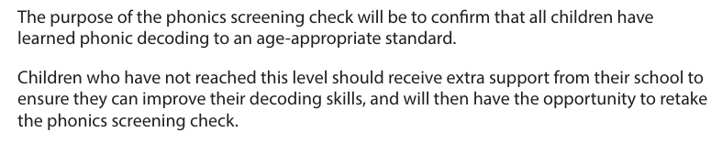
Why?
NG

Slide 4
Terminology
Digraph- 2 letters one sound eg/ oe, ar, er, ow
Trigraph- 3 letters one sound eg/air, ure, ear, igh
Split digraph – e_e (delete), a_e (make) o_e (phone), i_e (slime), u_e (cute)
(look for an e at the end)
Pure sound- mmmmmm not muh, ssssssssssss not suh
Alternative sounds eg/ ow (owl/snow) ea (meat/head)
SG

Slide 5
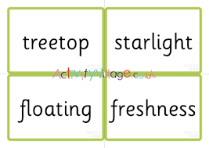
Chunk it up- (for longer words) cover up parts of the word, blend small parts and then blend together
SG

Slide 6
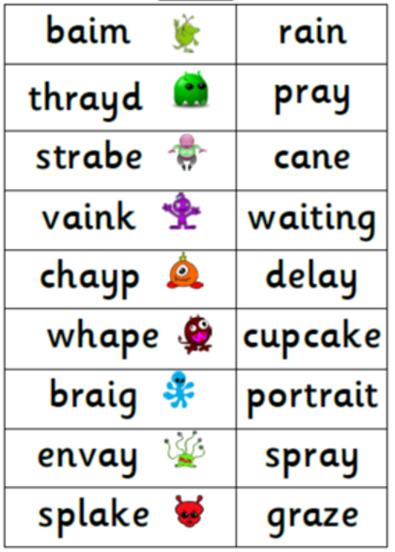
Spot the digraph or trigraph before reading the word.
Adding sound buttons.
NG

Slide 7
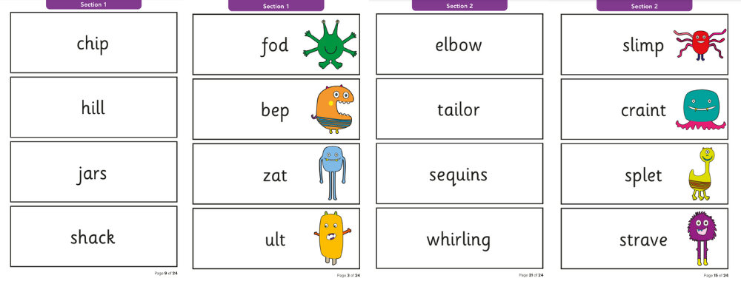
Alien word- can not make sense
Real word- Does it make sense?
NG

Slide 8
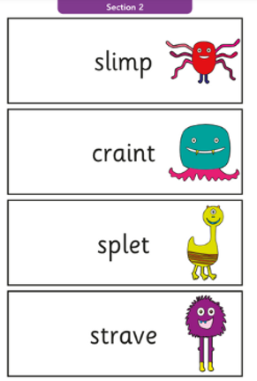
Split digraphs – ‘e’ alarm!
If you see an ‘e’ at the end of a word- check to see if it is a split digraph before sound it out.
If it ends in an ‘e’ stop and see.
SG

Slide 9
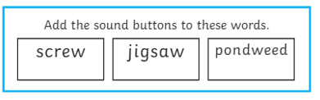
Sound buttons
NG

Slide 10
How can you help?
Spot the digraph or trigraph in a word first
Point to the letters- blend in their head.
Chunk it up
‘e’ alarm- split digraphs
Websites- letters and sounds, top marks
https://letters-and-sounds.com/#
https://ictgames.com/mobilePage/phonemePatterns/index.html
Read every night
If a word doesn’t make sense when reading, try it again. May need to use alternatives.
NG

Slide 11

Reading at home
Research consistently tells us that children who read for 10 minutes a day can make up to a year’s additional progress.
Reading enjoyment has been reported as more important for children’s educational success than their family’s socio economic status. – OECD, 2022
SG

Slide 12
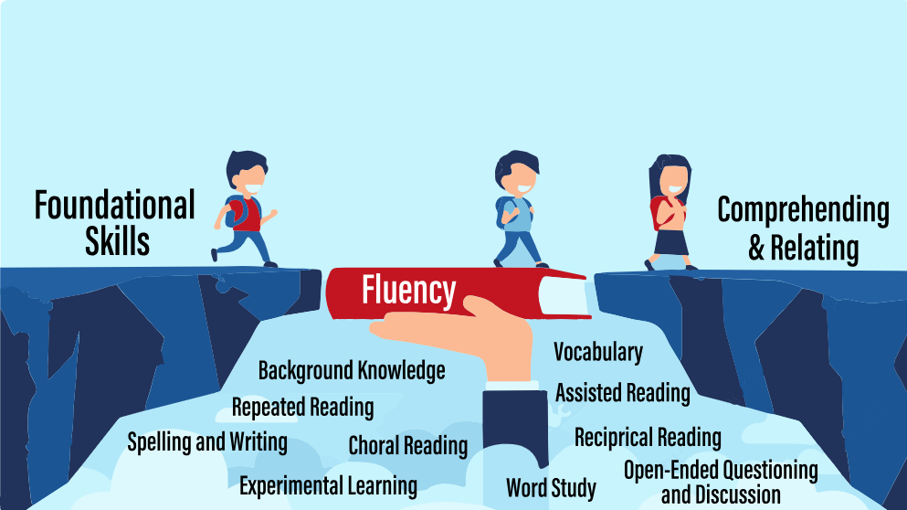
Fluency
As children become more confident at decoding words they need to practise fluency.
Fluency in reading refers to the ability to read text accurately, quickly, and with appropriate expression.
Fluent readers can focus on comprehension rather than struggling with word decoding.
Reading back sentences to support fluency is really important.
Reading books again.
Checking for understanding.
Model fluency reading to your child.
Look at punctuation – How will you change your voice?
SG

Slide 13
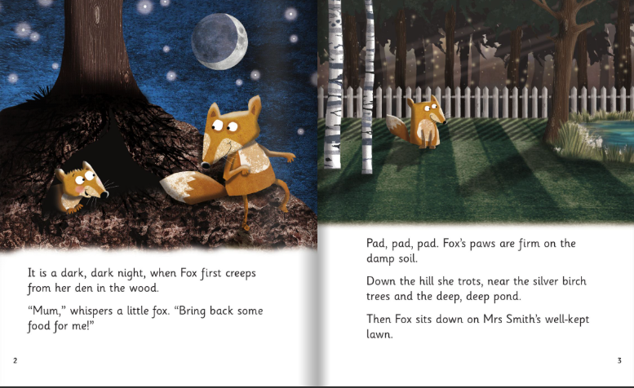
SG

Slide 14
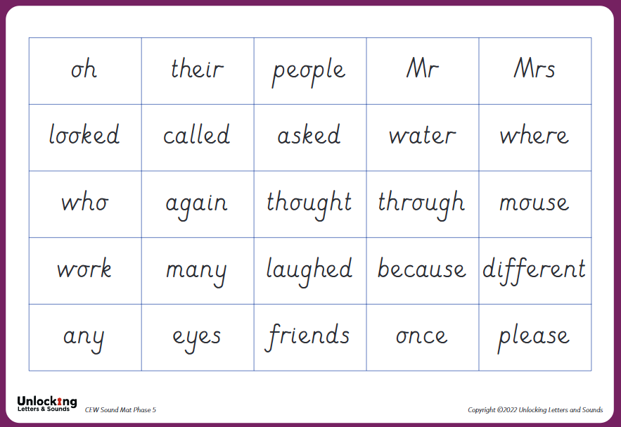
Common Exception Words
Some phonics clues and some tricky bits eg/ many
Need to read AND spell them
Front of reading diaries
QR codes in diaries
NG

Slide 15
Maths!
Maths- please practise counting in 2’s, 5’s and 10’s at home
Number bonds to 10.
(eg/ 1 and 9, 8 and 2 etc)
NG

Slide 16
Any questions?
NG

